Slide 1
Civil Protection
Topic 1: National civil protection and crysis management system.
2019/2020

Slide 2

WHAT IS CIVIL PROTECTION?
set of measures to ensure response in case of disaster or disaster threat, as well as to support the needs of national defence system in the event of military invasion or war;
essence: involvement of possible and necessary state, municipal, private and voluntary resources, as well as inhabitants.
International civil protection distinguishing mark

Slide 3
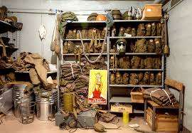

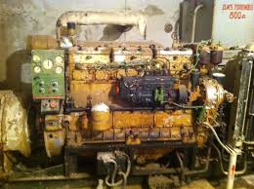
CIVIL PROTECTION
A set of
organisational;
engineerieng and technical;
economic;
financial;
social;
educational and scientific
measures
implemented by state, municipal authorities, society in order to ensure the safety of people, environment, property, as well as to take appropriate action in case of disasters and disaster threats.

Slide 4
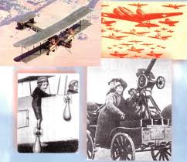
HISTORY OF CIVIL PROTECTION
Civil protection (CP) as a part of national defence system has improved in the course of development starting from local passive air defence system introduced in Latvia in 1934 and to present days. The origins of CP are connected with the emergence of aviation during the First World War (1914-1918), when local air defence was organised in many countries.

Slide 5
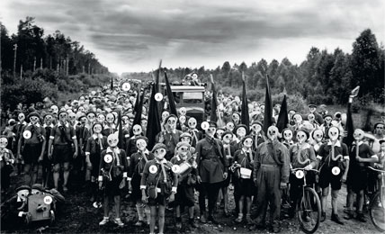
Air Defence
In order to pay more attention to air defence, on 2nd July, 1941 USSR Council of People’s Commissars adopted a decision on the inclusion of all citizens (men aged 16-60, women aged 18-55) in local air defence units.

Slide 6

Regulatory enactments
Civil Protection and Disaster Management Law;
National Security Law;
State Material Reserve Law;
Fire Safety and Fire-Fighting Law;
Labour Protection Law;
Until 01.01.2018. the following regulations shall be in force:
Cabinet Regulations Nr. 612 ;
Cabinet Regulations 423;
Cabinet Regulations 842;
Cabinet Regulations 659;
Cabinet Regulations 1072;
Cabinet Regulations 1078;
Cabinet Regulations Nr 626;
Cabinet Regulations Nr. 772;
Cabinet Regulations Nr. 530;
Cabinet Regulations Nr. 1260;

Slide 7

CPDM Law
The aim is to establish the competence of CP system and disaster management entities in order to ensure, as completely as possible, the safety of people, environment and property and protection in case of disasters or disaster threat.
Disaster is an event which has caused human victims and threatens human life or health, has caused damage or threatened perople, environment or property, as well as has caused or causes essential material and financial loss and exceeds the daily capacity of state and municipal authorities to prevent the devastating circumstances of the event.

Slide 8
Civil Protection System
The civil protection system is an integral part of the national security system consisting of state and municipal authorities, legal and natural persons with specified by law rights, tasks and responsibilities in the field of civil protection.
CPS is based on the administratively territorial principle. Basic units are municipalities and Republic cities.
In Latvia there are:
110 municipalities
9 Republic cities
Name of the city
Daugavpils
Jekabpils
Jelgava
Jurmala
Liepaja
Rezekne
Riga
Valmiera
Ventspils

Slide 9
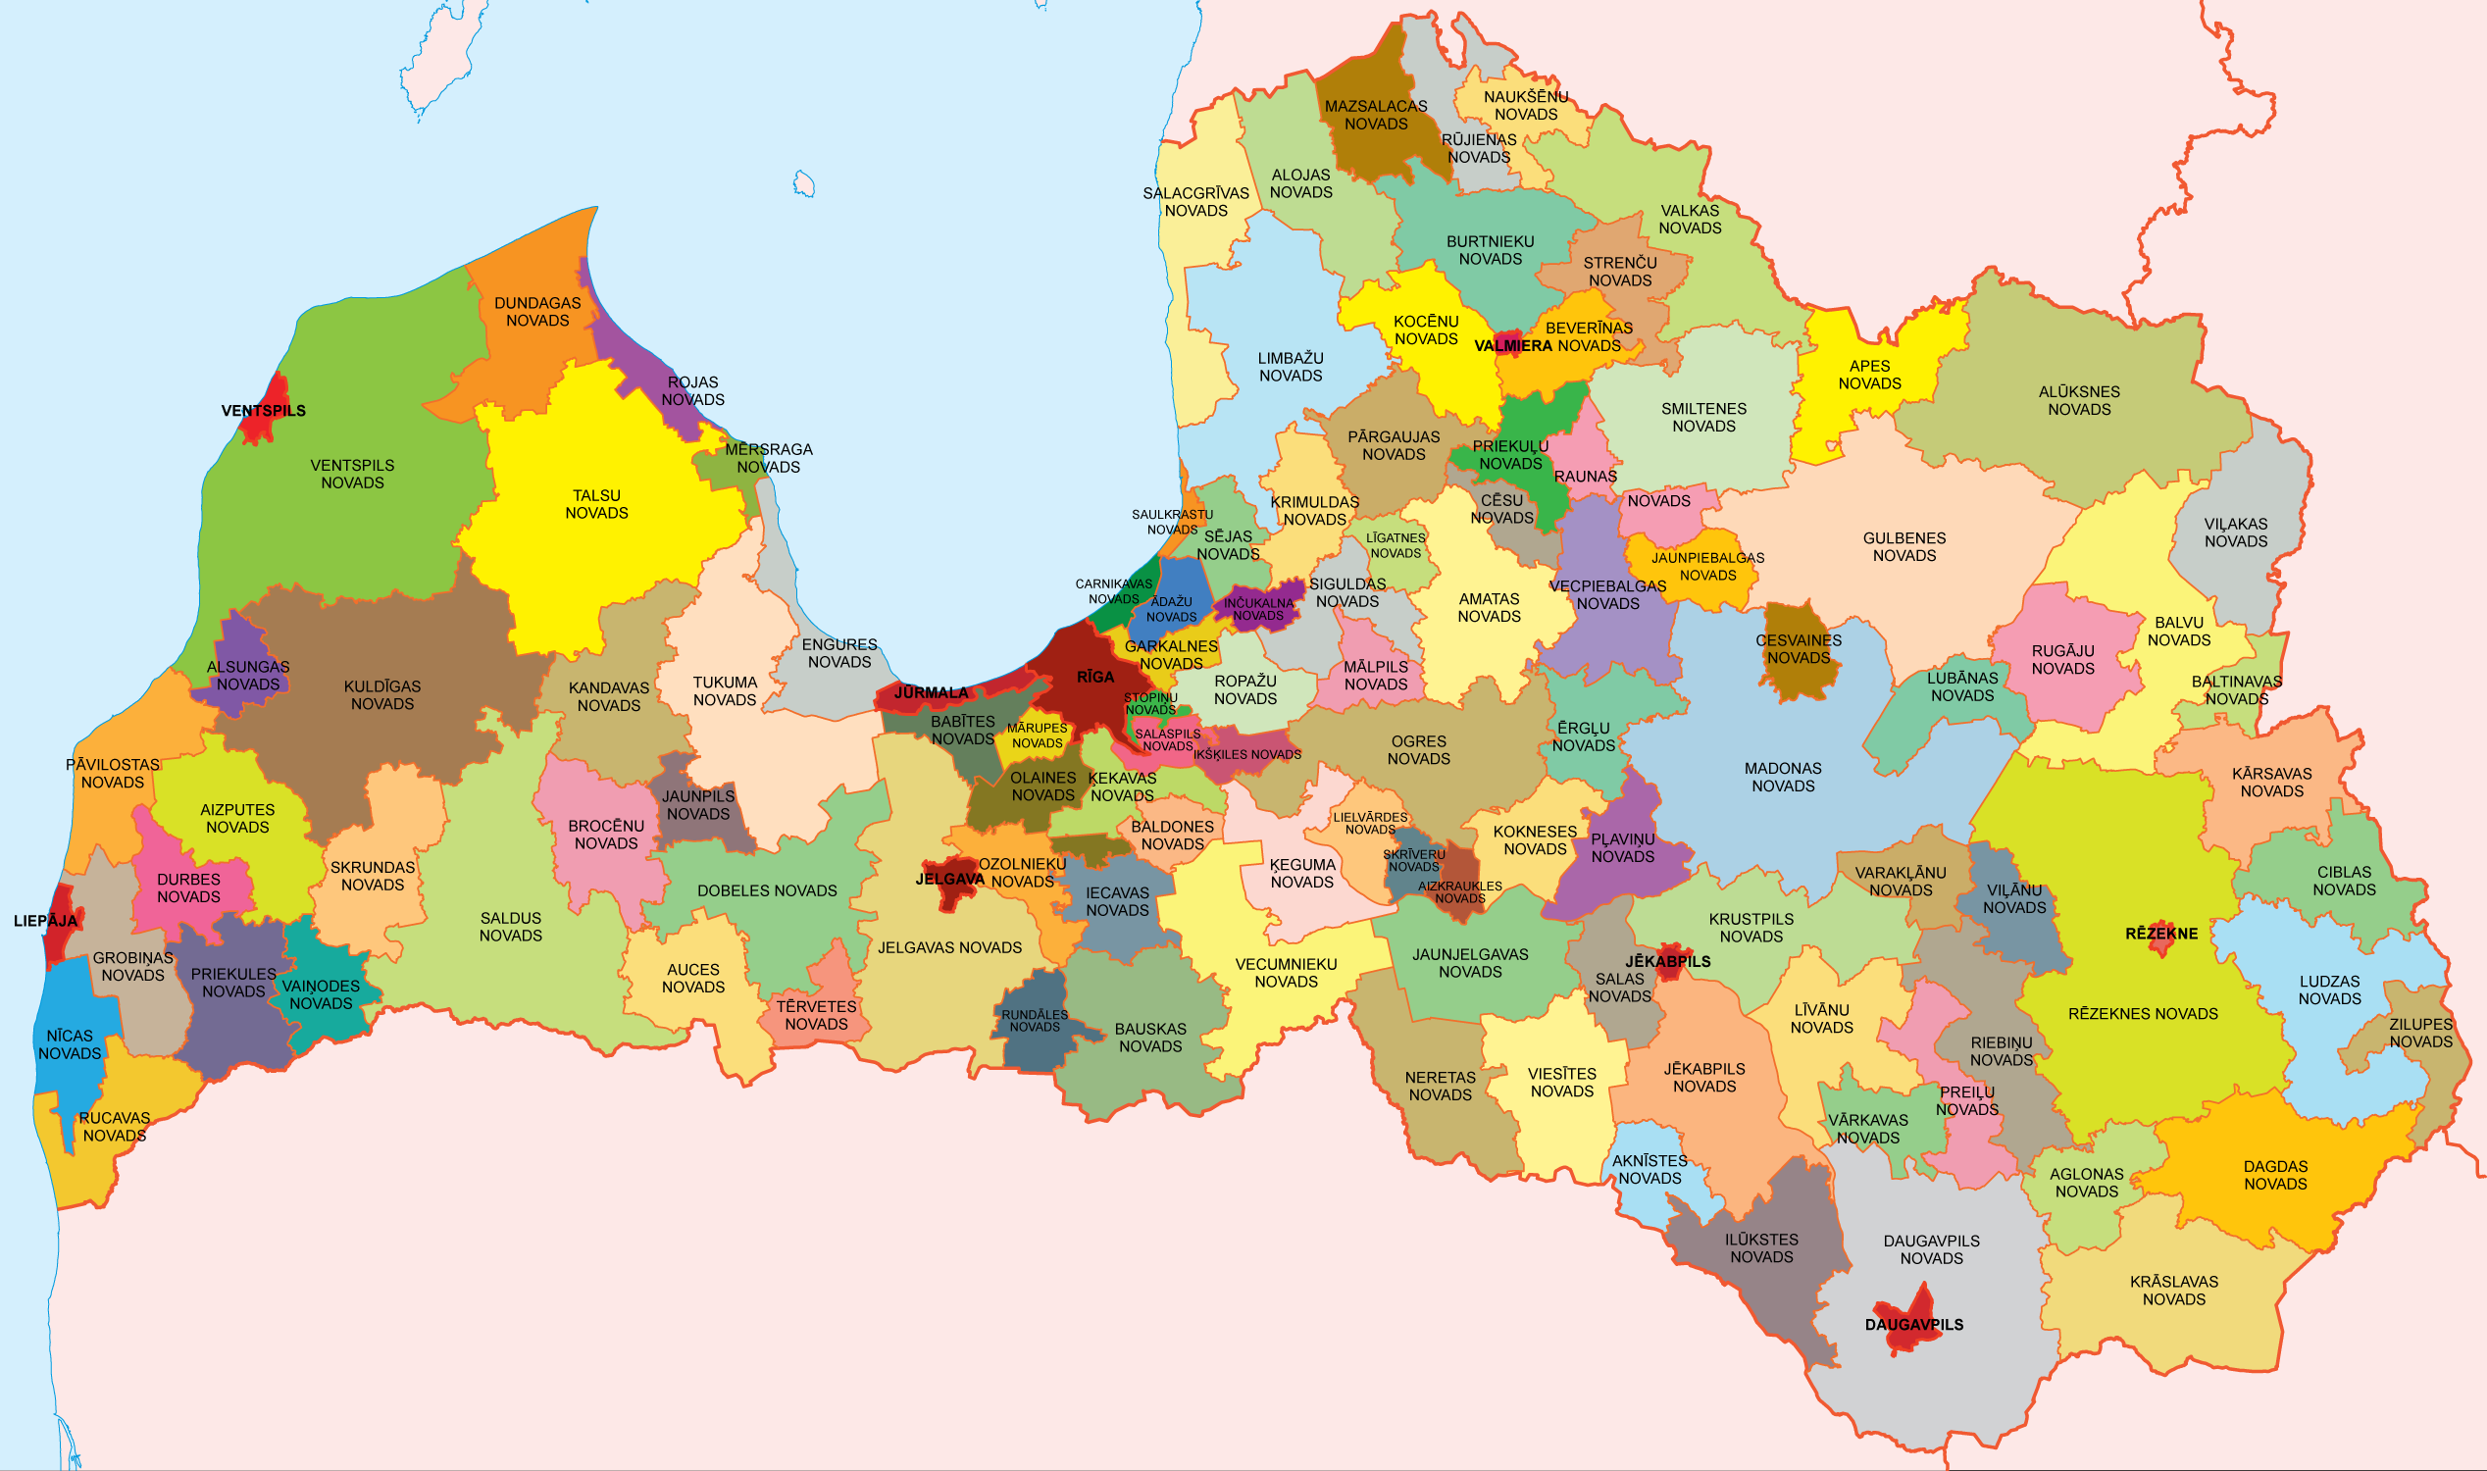

Slide 10
System Management
The Prime Minister shall be responsible for the operation of the system and the performance of its tasks.
Within the framework of the system, the measures of prevention and overcoming state threat situations shall be managed by the Prime Minister on national or regional level.
The State Fire-Fighting and Rescue Service shall manage, coordinate and control the operation of the system.
Depending on the type of disaster, emergency measures of response and elimination of consequences at the site of the event shall be managed by State Fire-Fighting and Rescue Service official or – in conformity with competence – an official of a state authority (hereinafter – the head of rescue works) specified in the National Defence Plan or in local government civil protection plans.

Slide 11
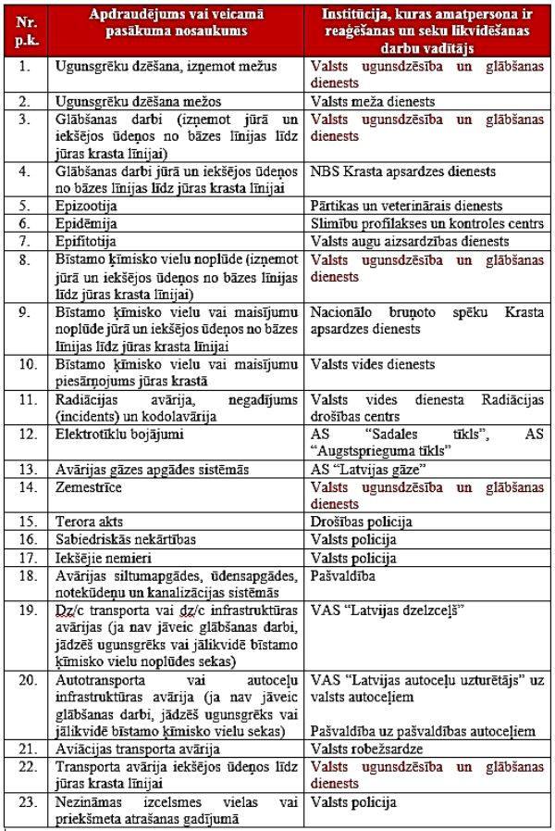
Institutions Responsible for the Elimination of Risks and the Provision of Assistance

Slide 12
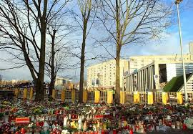
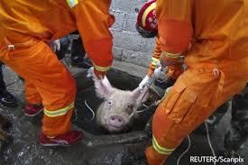
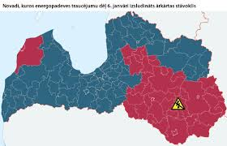
Emergency Situations
Special legal arrangements which can be announced in case of a national threat, disaster or its threat, as well as in case of a critical threat to infrastructure, if the safety of the state, society, environment and economy or human health and life are seriously threatened.

Slide 13
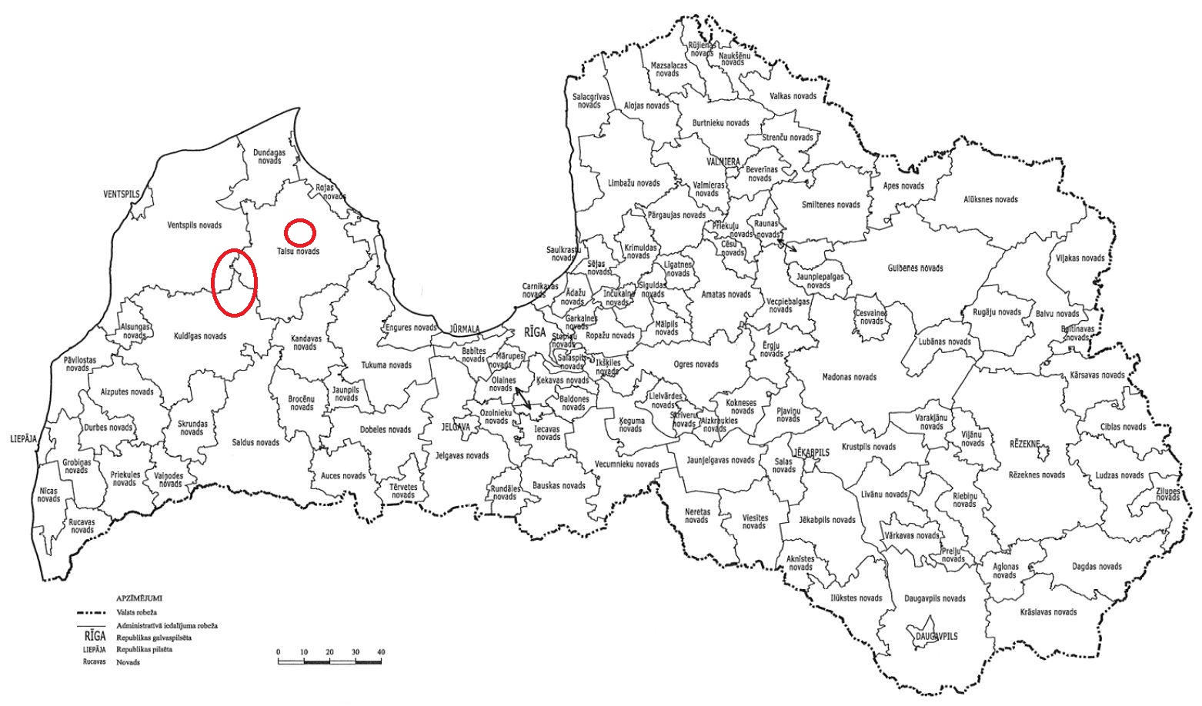
Disasters

Slide 14
Types and Scales of Disasters
According to the cause, the following disasters shall be distinguished:
natural disasters
man-made or anthropogenic disasters
Public riots, terror acts and internal disorders
According to the extent of the damage caused the following disasters shall be distinguished:
1) local-scale disasters – the extent of damage caused does not exceed the boundaries of the administrative territory of one local government;
2) regional-scale disasters – the extent of damage caused exceeds the boundaries of the administrative territory of one local government;
3) state-scale disasters – the damage caused by a disaster affects the entire territory of the state or a significant part of it.

Slide 15
Potential Types of Threats in the state:
Natural disasters:
1. Storms, rainstorms, snowfall, icing, snow-storm;
2. Earthquake;
3. Flood;
4. Forest and peat bog fire;
Man-made disasters a) Technogenic disasters:
5. Leakage of dangerous substances;
6. Radiation accidents;
7. Transport accidents;
8. Incidents in heating systems;
9. Incidents in gas supply system;
10. Incidents in water supply and sewer systems;
11. Electrical power network damage;
Epidemic, epizootics, epifitotija:
Outbreaks of dangerous infrctious diseases and other infectious diseases with significant and difficult-to-control spreading potential of infections (their threat);
Mass illness of animals and plants and dangerous infectious diseases;
Man-made disasters b) :
14. Public riots; Belarus
15. Terrorist attacks;
16. Armed conflict;
17. Collapse of buildings and constructions.

Slide 16
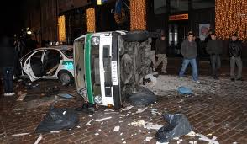
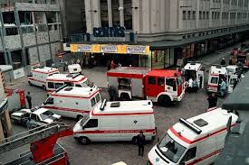
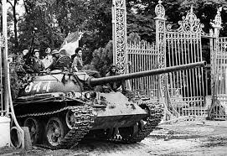
Public riots, terrorist attacks and war, military invasion or its threat
Armed groups may be involved in a military invasion to provoke a conflict situation between states or within one state affecting its territory or government.
Public riots may result in damage to human health, raiding state and municipal institutions, damage to vehicles.
In order to achieve their goals, terrorists most often use improvised explosive objects and firearms.

Slide 17
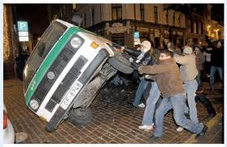
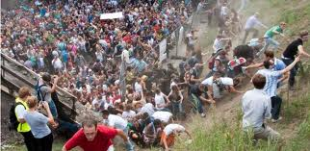
Public Riots
* Consequences:
Damage to human health;
Raiding state and municipal institutions;
Damage to vehicles etc.

Slide 18
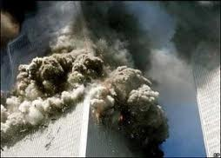
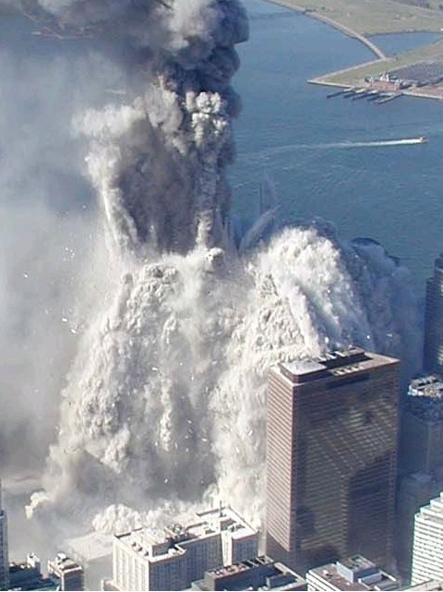
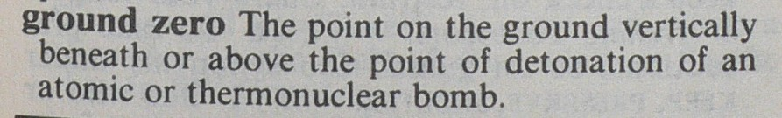
Terrorist Attacks
Most often improvised explosive objects or firearms are used. A terrorist attack with chemical, biological or radioactive substances may potentially have a particularly negative effect.

Slide 19
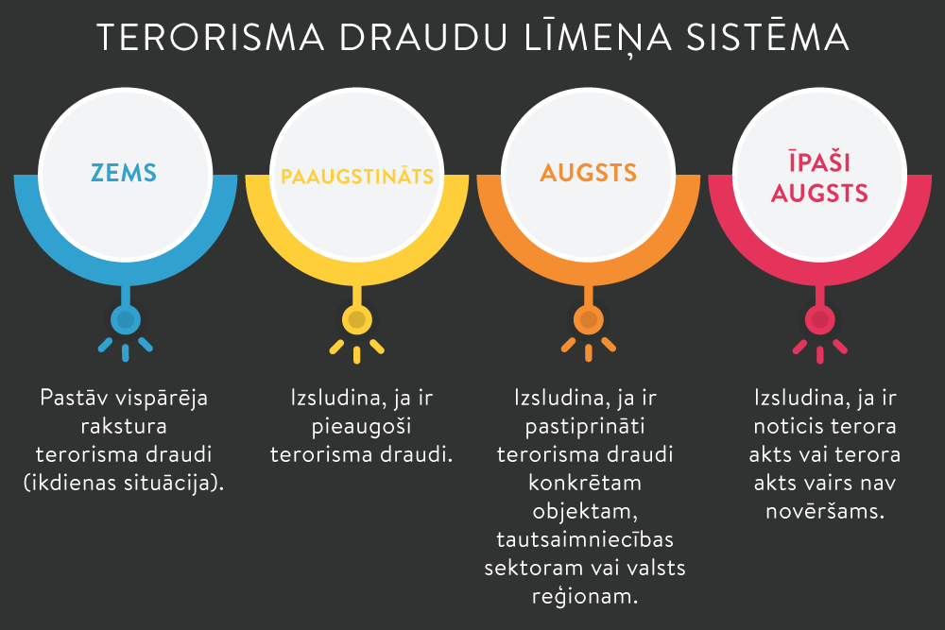
Levels of terrorism threats
Depending on the probability of terrorist threats and the negative effects of potential consequences, the following levels of terrorism threats are announced:
1) low level of terrorist threats (colour code – blue) if there is s general terrorist threat;
2) heightened level of terrorism threats (colour code – yellow) if there is a growing threat of terrorism;
3) high level of terrorism threats (colour code – orange) if the threat of terrorism to a specific object, economic sector or country region has been confirmed;
4) particularly high level of terrorism threats (colour code – red) if a terrorist act has occurred or a terrorist act is no longer preventable.

Slide 20
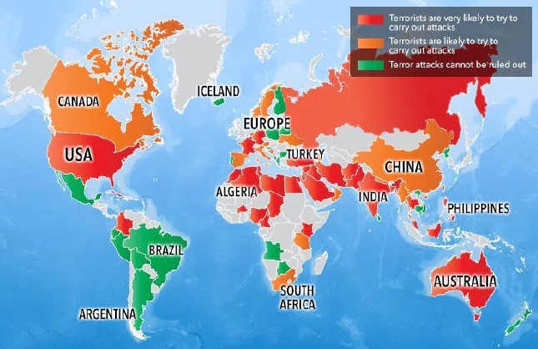
The levels or terrorist threats may be announced for:
1) the whole territory of the state;
2) an endangered state region;
3) an endangered economic sector;
4) an endangered object.

Slide 21
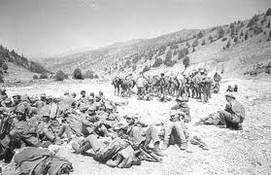
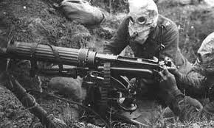
War, military invasion or their threat
War, military invasion or their threats may occur in the border zone or inland area. They may involve armed groups to provoke a conflict situation between states or within one state affecting the territory of the state or its government.

Slide 22
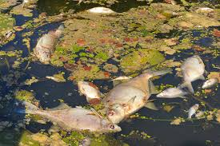
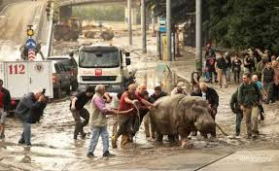
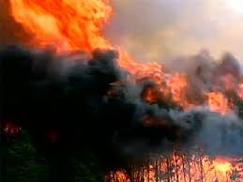
Natural Disasters
Are extreme geophysical events, biological rocesses and major technological accidents connected with the release of huge energy or movement of materials, that cause major and unpredicted threat for life and may cause significant damage to material values and environment.

Slide 23
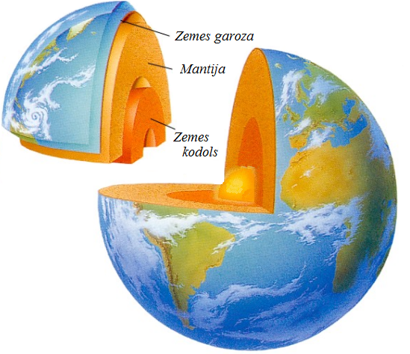
Natural Disasters
a) Geophysical – earthquakes, landslides;
b) Hydrological – pales, floods, ice jams;
c)Meteorological – rainstorms, hail, heavy snow, storms, tornadoes;
d)Climatological – strong frost or heat, icing, drought, forest and peat bog fires;
e) Biological – epidemics, epizootics, epiphitotics;
f)Cosmic – drop-off of meteorites, geomagnetic storms.

Slide 24
Natural Disasters
Danger may affect
People – death, injuries, diseases, stress;
Property – loss, damage, economic damage;
Environment – pollution, loss of flora and fauna, loss of attraction

Slide 25
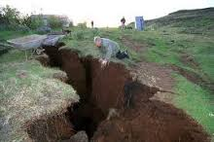
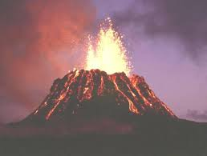
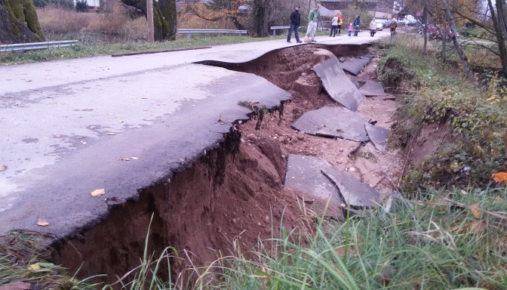
«Geological factors»
Earthquakes
Volcanic eruptions
Slides
Avalanches and landslides

Slide 26
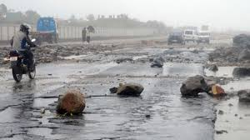
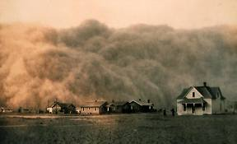
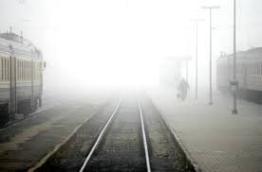
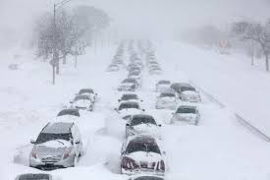
«Atmosphere factors»
Hurricanes, typhoons
Storm, fog
Heat or cold waves
Rainstorms
Snowfall, hail
Snow-storm, icing

Slide 27
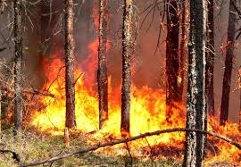
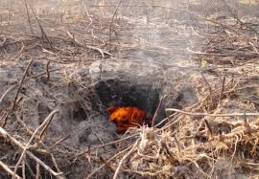
Nature fires
Forest
Peat

Slide 28
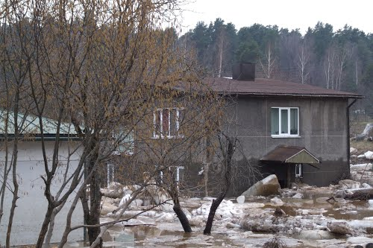
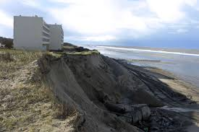
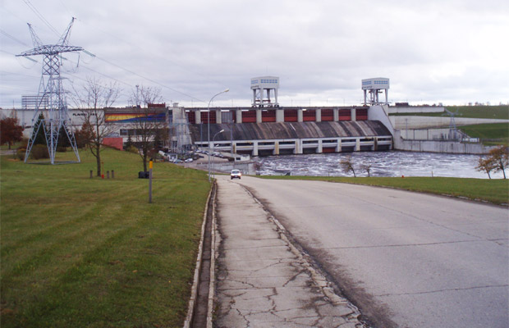
«Hydrosphere factors»
Flood
Coastal erosion
Water surge
Dam ruptures

Slide 29
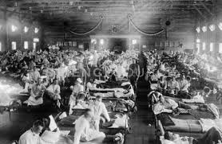
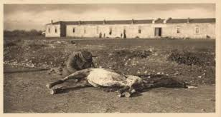

Biological factors Diseases
Epidemic
Epizootic
Epiphitotic

Slide 30
Human-caused or anthropogenic disasters Technogenic disasters
Arise from leakages of chemical, radioactive and biological substances, fires that start in buildings and construction sites, explosions, breaks in dams and other hydrotechnical structures, damage to electric power networks, incidents with public networks, collapse of buildings and constructions or transport accidents.

Slide 31
Technogenic Disasters
2 causes
Cause 1:
Cause 2:
Changes in production processes;
Use of aggressive components;
Design errors;
Concentration of companies (domino effect).
Low employee discipline;
Non-compliance with operational rules.

Slide 32
Thank you for your attention!

